Slide 1


BY
MANASA CHELUKALA
REG NO: 811186837

Slide 2
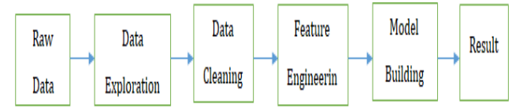
Problem Statement
The data scientists at BigMart have collected 2013 sales data for 1559 products across 10 stores in different cities. Also, certain attributes of each product and store have been defined. The aim is to build a predictive model and find out the sales of each product at a particular store.
Using this model, BigMart will try to understand the properties of products and stores which play a key role in increasing sales.
Methodology:

Slide 3
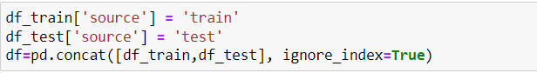
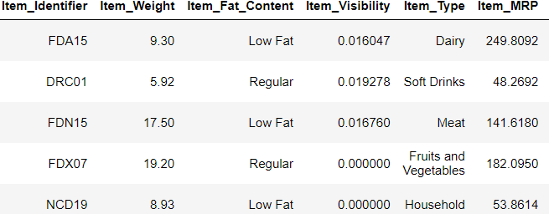
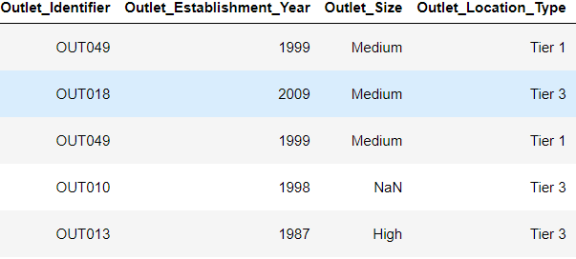
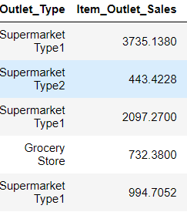
Exploratory Data Analysis
Insights:
Item_Visibility contains 0.000 as values-meaningless
Item_Identifier is a string with specific code
Outlet_size contains NaN values

Slide 4
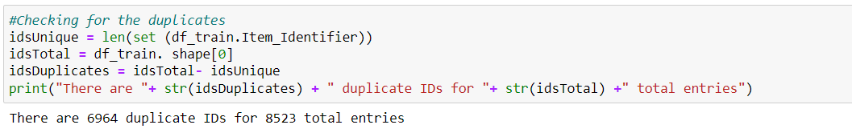
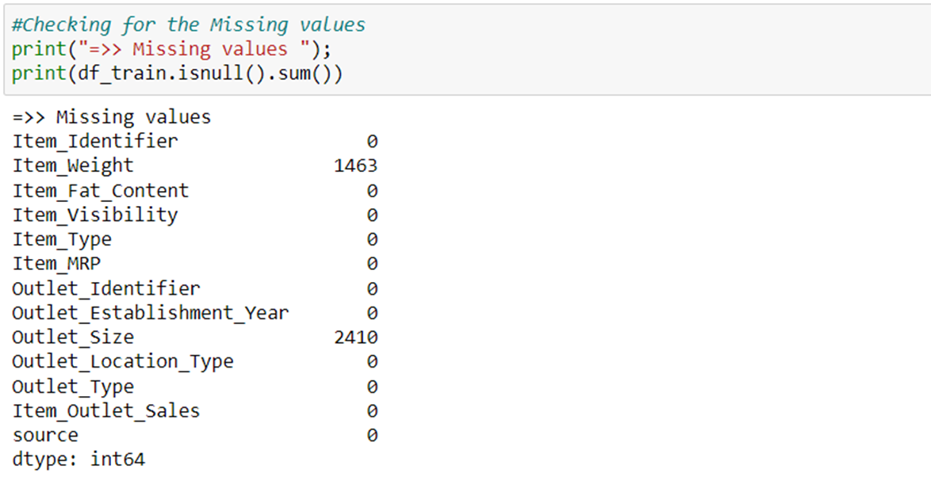
Duplicates and Missing values
Insights:
No of Duplicates:6964.
Possible reason: Same product can exist in multiple stores.
Item_identifier has 1463 missing values
Outlet_size has 2410 missing values

Slide 5
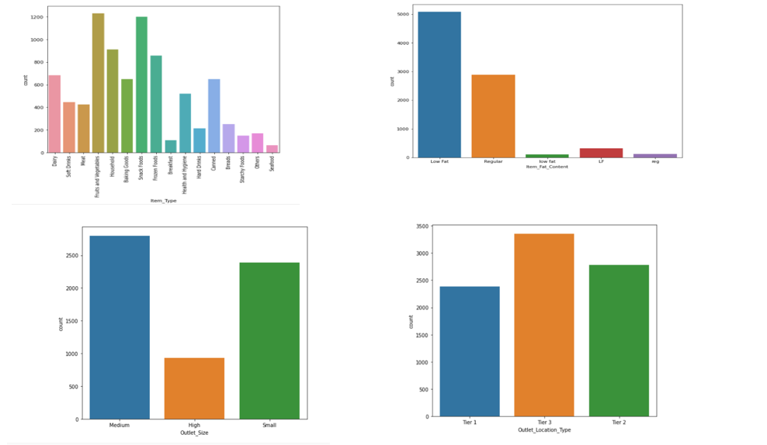
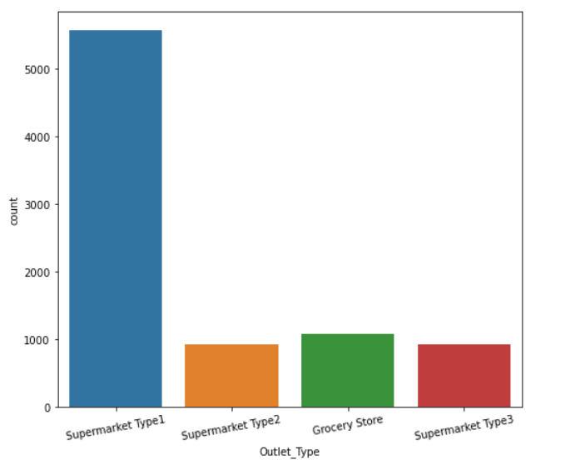
Univariate Analysis
Insights:
16 different types
Possibility to reduce item_types to <16
Replace 5 types with 2- Regular & Low Fat.
More no. of Medium & Small size outlets.
Big Mart is Present more in Tier 3 and Tier2 than in Tier1 cities
Supermarket Type1 is prominent

Slide 6
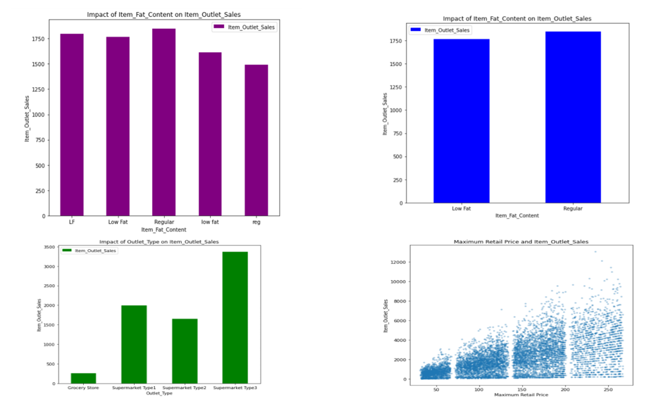
BiVariate Analysis
Insights:
Low Fat product sales > Regular fat sales
Medium SuperMarket Type3 has more sales than others.
In the relationship between the item identifiers and the outlet size, the items are purchased more frequently as the outlet size increases

Slide 7
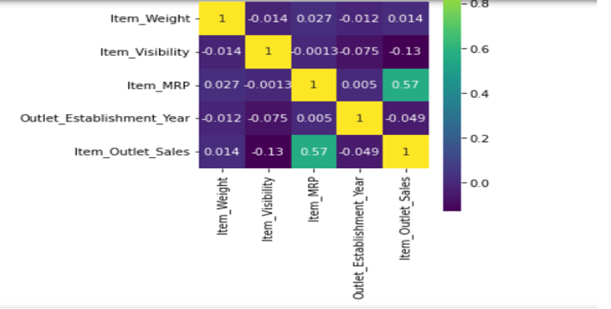
Correlation between different attributes
Insights:
Item_Visibility has lowest Correlation with target variable.
Item_MRP has strong positive correlation with target variable.

Slide 8
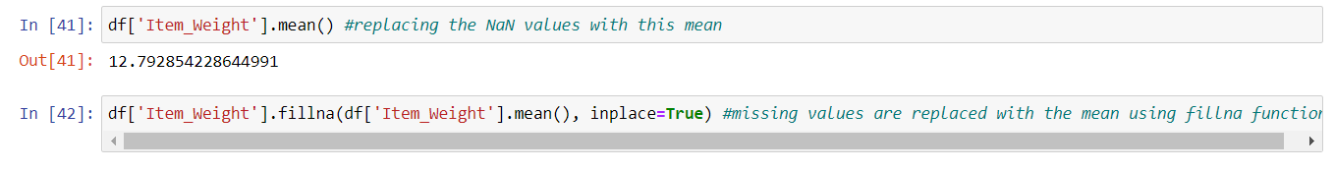
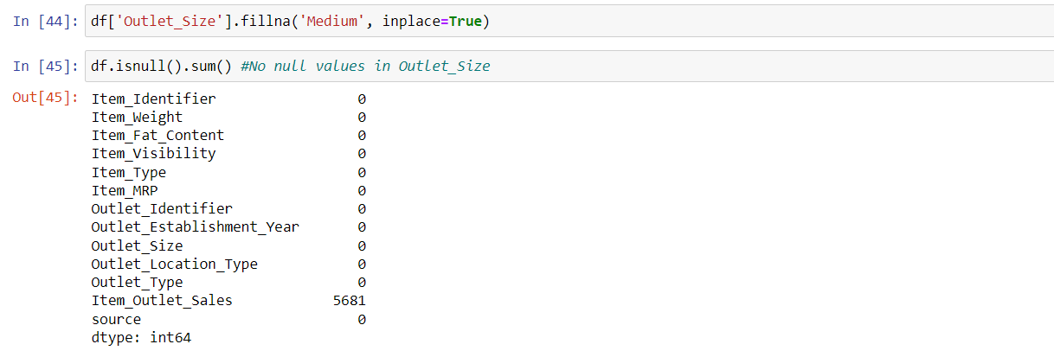
Data Cleaning Replacing NaN in Item_Weight
Insights:
Missing values in Item_weight are replaced.
Replaced missing vales with mode-size of outlets are few and makes sense to replace the missing with most prominent outlets.

Slide 9
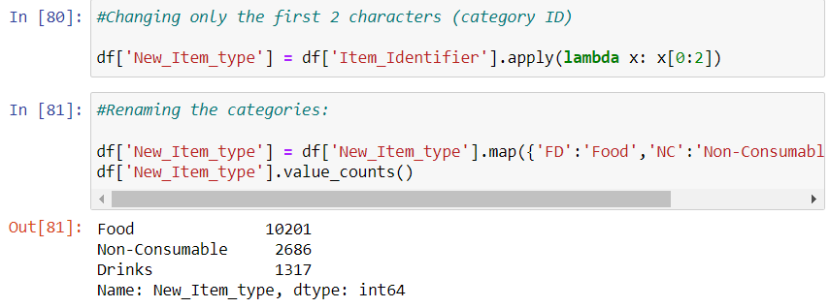
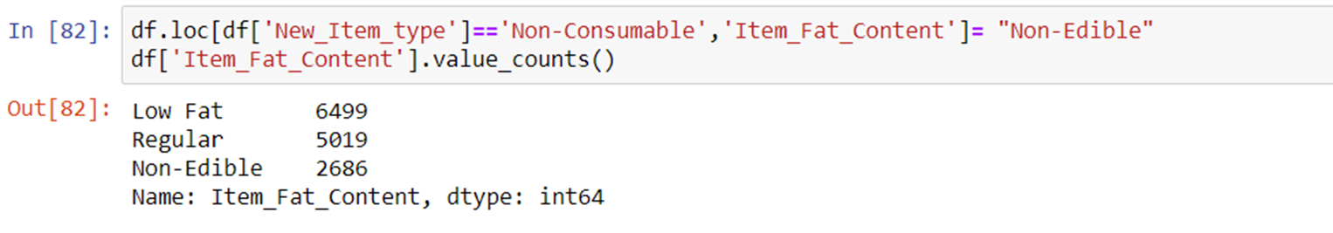
Feature Engineering
Insights:
Item_Type has 16 categories which won’t be useful,transform them into 3 broad categories.
Item_Type has non-consumable items which are categorized as fat contents,these needs to be segregated as non-edible.

Slide 10
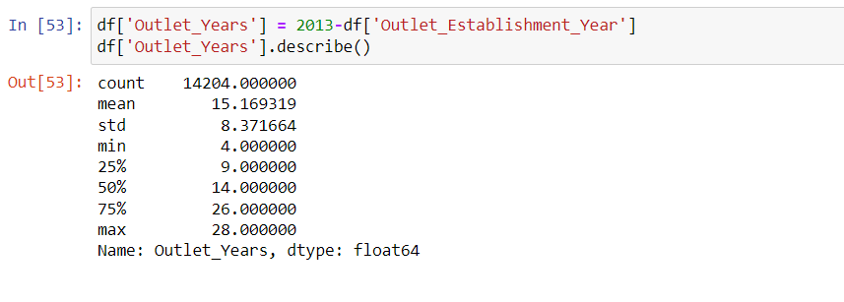
Outlet_Establishment_Years - Years of Operation of a store
Comparing the year of establishment of a store makes no sense. Transforming into no of years of existence makes a good correlation to outlet_sales.
Since the latest year of establishment is 2013, subtract all from 2013 to get no of years of operation.

Slide 11
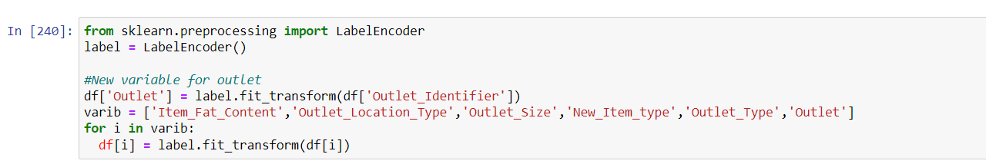
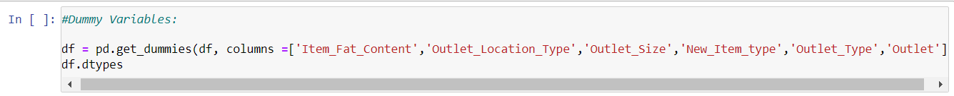
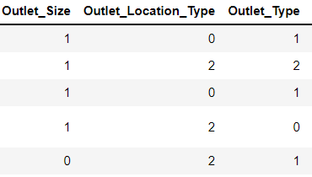
Categorical Variables transformation
Insights:
scikit-learn library only accepts numerical variables so convert all categorical fields into numericals.
Having pure numericals will cause confusion as which is greater than other. So create dummies to avoid confusion.
Fields Item_Type &
Outlet_Establishment._Year are dropped.

Slide 12
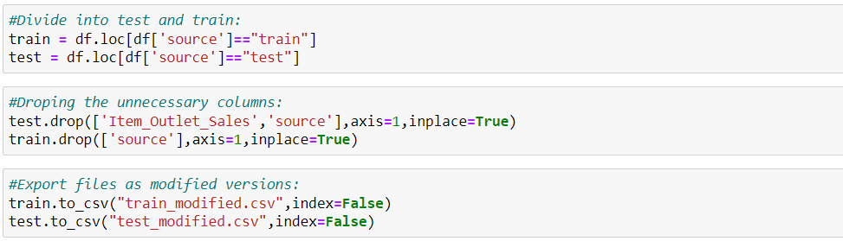
Model Building Separate train & test dataset
Segregating the data into train and test dataset for model prediction.
Insights:
Remove Item Outlet sales from test data and the source.
Remove source from train data.

Slide 13
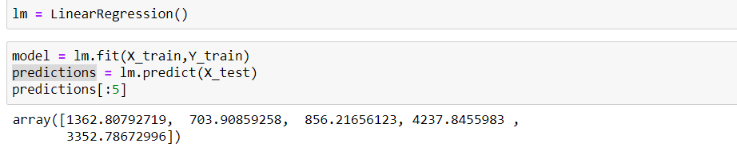
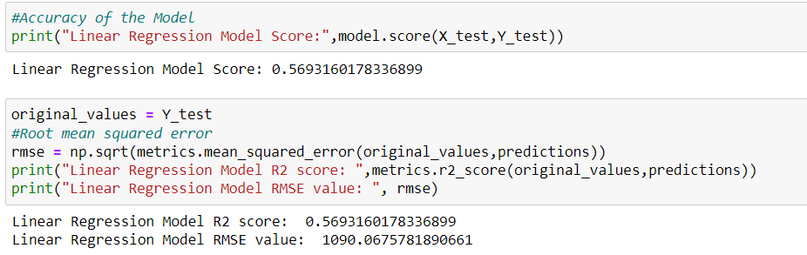
Linear Regression Model
The RMSE value of the Linear Regression Model is 1090.0675.

Slide 14
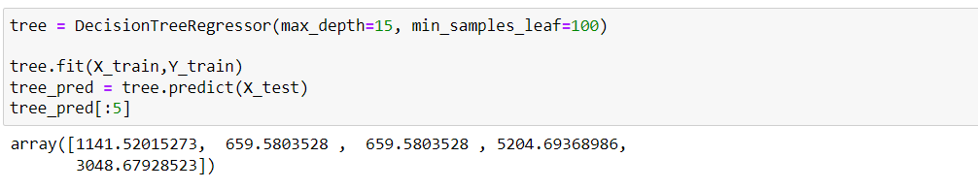
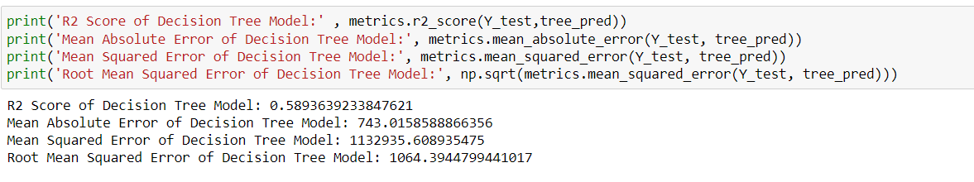
Decision Tree Model
The RMSE value of the Decision Tree Model is 1064.3944.

Slide 15
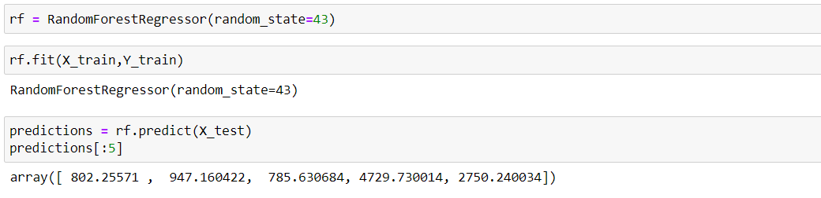
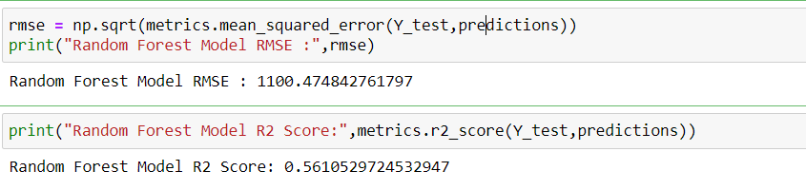
Random Forest Model
The RMSE value of the Random Forest Model is 1100.474.

Slide 16
Results
Linear Regression Model RMSE value: 1090.067
Decision Tree Model RMSE value : 1064.394
Random Forest Model RMSE : 1100.474
Outlet_Type and Item_MRP are the key factors affecting the Outlet_Sales.
Random Forest Model is the most accurate Predicted model

Slide 17
Conclusion
The goal of this project was to discuss how machine learning algorithms such as linear regression, decision trees, and random forests can be used to build different machine learning models.
Sales results have been predicted using these algorithms
According to the accuracy predicted by different models, decision trees and random forests are the best.
Using our predictions, big stores can refine their methodologies and strategies, resulting in increased profitability.

Slide 18
Thank You!!

